Slide 1
21 days of JavaScript boot camp
Console.log(“I am learning”)

Slide 2
PREREQUISITES AND ONBOARDING
DAY 0

Slide 3
SETTING UP PROCESS
CREATE A GITHUB ACCOUNT: https://github.com/
DOWNLOAD GITHUB DESKTOP
DOWNLOAD VISUAL STUDIO CODE
CONNECTING YOUR GITHUB ACCOUNT TO YOUR APPLICATION
VISUAL STUDIO CODE EXTENSIONS
BASIC FOLDER STRUCTURE
PUSHING A PROJECT TO GITHUB

Slide 4
Definition of terms
GIT -
Git is a distributed version control system that tracks changes in any set of computer files, usually used for coordinating work among programmers collaboratively developing source code during software development.
GITHUB
GitHub is a web-based version and collaboration platform for software developers. An account is essential for storing, tracking and collaborating on coding projects. It makes it easy for developers to share code files and collaborate with fellow developers on open-source projects.
VISUAL STUDIO CODE - Visual Studio Code is a code editor redefined and optimized for building and debugging modern web and cloud applications.

Slide 5
Definition of terms
Basic Folder files for every project:
index.html file
Assets folder – images and videos
Style.css (could create a folder if there are multiple)
Main.js
Readme.md

Slide 6
DAY 00 TASKS
Create a GitHub account: post link in the group
Download visual studio code and GitHub desktop
Connect GitHub desktop to your GitHub account and local folder
Create a basic project folder with necessary files
Push it to your GitHub account

Slide 7
HTML: INTRODUCTION, BASIC STRUCTURE AND TAGS
DAY 01

Slide 8
Introduction to html
The Hypertext Markup Language or HTML is the standard markup language for documents designed to be displayed in a web browser. It defines the content and structure of web content.
It was developed by Sir Tim Berners-Lee based on the concept of linking any document to any other document via the internet.
Sir Tim Berner Lee’s breakthrough in trying to establish a high level network of content that allows any document to link to any other document were:
HyperText Transfer Protocol (HTTP) – the foundation of data for communication for the web
HyperText Markup Language (HTML) – the main mark-up language for creating Web Pages and information that can be displayed on a web browser
Uniform Resource Locator (URL)/ web addresses – used to reference a web page

Slide 9
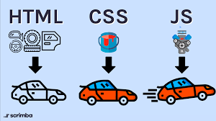
RELATIONSHIP BETWEEN HTML, CSS AND JAVASCRIPT
HTML – This is the fundamental language behind everything you see on a browser and is the main structure of a web page. It is where headings, sections, links, figures and images are placed on a web page.
CSS – It is used for styling your HTML page and making it appealing and controls the positioning of different elements, color, fonts, display, shapes and so much more.
JAVASCRIPT – It controls the action of the page and interaction with the user. It basically adds functionality. HTML and CSS makes a webpage like a written page, but with JS, a webpage has the potential of being a web application.
HTML defines the structure of your content, CSS determines the style and layout, and JavaScript makes the content interactive; therefore, it makes the most sense to learn them in that order

Slide 10
TAGS, ELEMENTS AND ATTRIBUTES
(putting the “M” in HTML)
The “M” in HTML is for Markup, which means to annotate a document with extra information. For e.g. where different sections and paragraphs beging and end, which part is a title and which things should be emphasized and so on.
We use angle brackets (“<“ and “<“) to separate the “annotations from regular text. In HTML, this annotations are called “tags”
Elements – These are the pieces themselves i.e a paragraph, a header
Tags – A tag is used to organize a text file. There are tags with similar effect on code, but one can be for semantic, the other for styling.
Attribute – More information about an element e.g. id’s and classes

Slide 11
CHARACTER ENCODING
Character encoding is a method of converting bytes into characters. A character can be any letter, digit or symbol that makes up words and languages(including languages with ideography's and symbols)
In character encoding, each character is assigned a particular number called a code point and the code point is stored in computer memory in form of bytes.
So, it is what is used as a reference to map code points into bytes to store in computer memory, then when a character in HTML is used, the bytes are read back into code points using the character encoding. Eg. ASCII, Unicode
This is important because it provides the right dictionary to code and in processing unfamiliar characters.
Note: Always use the Unicode character encoding: UTF-8 for webpages.
<meta charset=“utf-8”>

Slide 12
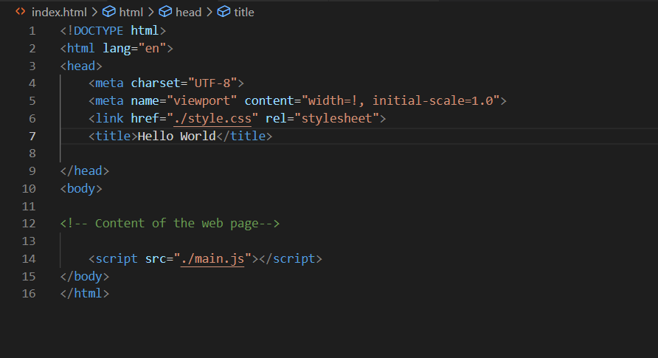
Basic structure of a html document

Slide 13
“HELLO WORLD”
LIVE DEMO

Slide 14
“TIPS AND TRICKS”
Inspecting a web page

Slide 15
DAY 01 TASKS
Create a github project: 21-days-of-javascript, and within it create a folder for day 01
Create the primary files within this folder
Write a simple html file with the basic structure
Link this to the html and javascript code files
For the HTML document:
Link other pages through the link tags
Add images to your html page
Push this to your github account
Research on more tags and character references

Slide 16
CSS: FUNDAMENTALS, SELECTORS AND STYLING
DAY 02

Slide 17
CSS FUNDAMENTALS
CSS is a language used to style HTML content on a web page. CSS is the acronym of “Cascading Style Sheets”. CSS is a computer language for laying out and structuring web pages (HTML or XML). This language contains coding elements and is composed of these “cascading style sheets” which are equally called CSS files.
CSS syntax can either be written as a ruleset or in line with HTML code. And CSS can either be an internal or an external stylesheet.
An internal style sheet is created by using the style element within HTML files and this element must be placed within the head element.
An external style sheet is created by using the .css file name extension and linking your css file with you html file. The link tag requires the following attributes:
Href – the value of this attribute must be the path address to the css file
Rel – decribes the relationship between the two files and it is "stylesheet"

Slide 18
INLINE Syntax
Terminologies used:
Opening tag – The start of an HTML element. This is the element that will be styled
Attribute – The style attribute is used to add CSS inline styles to a HTML element
Declaration – The group name for a property and value pair that applies a style to the selected element
Property – The first part of the declaration that signifies what visual characteristic of the element is to be modified
Value – The second part of the declaration that signifies the value of the property

Slide 19
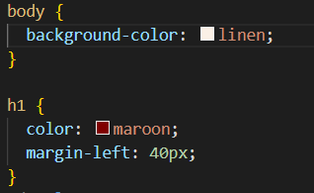
Ruleset syntax
Terminologies used:
Selector – The beginning of the ruleset used to target the element that will be styled
Declaration Block – This is the code in between {} that contains the css declarations
Declaration – The group name for a property and value pair that applices a style to the selected element
Property – The first part of the declaration that signifies what visual characteristic of the element is being modified
Value – The second part of the declaration that signifies the value of the property
Comments – additional information that is not considered as the CSS and will not affect the HTML code

Slide 20
CSS SELECTORS
A selector is used to target the specific HTML elements to be styled by a declaration.
Types of Selectors:
The Type Selectors – it matches the type of element in the HTML document.
Universal Selectors – It selects all the elements of any type. It uses the *in place of a specified selector
Class Selectors – It is used in selecting elements with the same class attribute. A (.) must be prepended to the class's name
ID Selectors – It is used to best style an element uniquely by using it's ID attribute and a (#) is prepended to the id's name
Attribute Selectors – It is used to target HTML elements that already contain attributes. E.g. [href]{style}
Pseudo-class selectors – It is used to change the appearance of a certain element after user interaction. E.g. focus, visited, disabled, active.

Slide 21
CSS Styling
Font-size
Font-weight
Text align
Color
Background color
Opacity
Background
Height
Z-index

Slide 22
“TIPS AND TRICKS”
To practice CSS, browse and web designs on dribble or behance.NET and write code to match that design

Slide 23
DAY 02 TASKS
Create a github project: 21-days-of-javascript, and within it create a folder for day 02
Create the primary files within this folder
Write a simple html file with the basic structure of any topic (other than the one for day 01)
Link this to the html and JavaScript and css code files
Style your html page with css(make sure to use all the selectors that have been covered today)
Submit your github repo for day 02 tasks in the group

Slide 24
CSS: RESPONSIVE DESIGN
DAY 03

Slide 25
WHAT IS RESPONSIVE DESIGN:
Responsive web design is about creating web pages that look good on all devices!
A responsive web design will automatically adjust for different screen sizes and viewports.
Responsive Web Design is about using HTML and CSS to automatically resize, hide, shrink, or enlarge, a website, to make it look good on all devices (desktops, tablets, and phones):
There are different tools we use in doing web responsive design. We can use CSS styles, media queries, JavaScript, the box model etc etc
The first step to creating a responsive website is by adding the metatag to all the web pages:
This sets the viewport of the page and gives the browser instructions on how to control the page’s dimensions and scaling.

Slide 26
How do we go about designing our websites Responsively with css styles:
Some key elements:
Position – changes the default position of element blocks to relative, absolute, fixed, sticky or static
Display – this dictates whether an element can share space with other elements’ values. Display can either be inline, flex, grid, block, inline-block etc etc
Float – (mostly used for wrapping images) moves an element as far left or as far right as possible
Clear – specifies how elements should behave when they bump into each other on the page
Grid – defines the element as a grid container and every child element inside it as a grid item e.g. grid-template-rows, grid-template-columns
Width and height – For example, for responsive images, the width property can be set t 100%

Slide 27
Using THE BOX MODEL
Box Model is the interpretation that all elements on a web page are interpreted by the browser as ‘living’ inside of a box.
Margin
height
Border
Padding
width
button

Slide 28
“TIPS AND TRICKS”
Avoid fixed sizes e.g. 1000px

Slide 29
BONUS SESSION
HOSTING A WEBSITE ON GITHUB PAGES

Slide 30
Day 02 tasks
RESEARCH ON WEB RESPONSIVENESS TOOLS, e.g. MEDIA QUERIES
FILL THIS FORM: https://forms.office.com/r/U1QFvL6Grb

Slide 31
PROJECT ONE
Html and CSS only
Due : MONDAY 8TH JANUARY 2023, 10.00AM

Slide 32
PROJECT prompt
Pick a product or a service (Hair dressing, Food, Books etc. ). Create a marketing website for this product or service using HTML and CSS. It should be fully responsive and have links to other pages.

Slide 33
PROJECT guidelines
Create a github project: 21-days-of-javascript, and within it create a folder for day 03
Create the primary files within this folder for the project that you have selected
Link this to the html and JavaScript and css code files
Create html content and Style your html page with css
Design for mobile size as well and make sure your website is responsive
Host your website page on GITHUB Pages and share the link in the group
PROJECT deliverables
Your web page should have been designed responsively
Your website should have all the elements correctly positioned
Your web page should have everything we have covered this week
Submit your web pages before the deadline

Slide 34
JavaScript: INTRODUCTION, VARIABLES AND DATA TYPES
DAY 04

Slide 35
INTRODUCTION
JavaScript is among the most powerful and flexible programming languages of the web. It powers the dynamic behaviour of most websites.
JavaScript is a scripting language that enables you to create dynamically updating content, control multimedia, animate images, and pretty much everything else.
The Console:
The console is a panel that displays important messages, like errors for developers. To see things, we can print log to our console directly.
Keywords:
Words that are built into the JavaScript language, so the computer recognizes them and treats them specially.
Properties
All data types have access to specific properties that are passed down to each instance. For instance every string has a property called length that stores the number of characters in that string. Property info is retrieved by appending the string with a (.) and the property name. (The (.) is considered an operator.
Methods
Data types have access to specific methods that allows us to handle instances of that data type. We call them by appending an instance with (.), the name of the method and opening and closing parenthesis

Slide 36
VARIABLES
A variable is a container for a value. They provide a way of labelling data with a descriptive name, so a program can be understood more clearly.
A variable is used to:
Describe data
Store/update info store in a variable
Reference/get info stored in a variable
Initializing variables in JavaScript
It is a two step process; declaration(giving a name) and assignment(giving a value)
Declaring a variable
We use the keyword ‘var’, ‘let’ or ‘const’
Var is re-declarable and re-assignable (not commonly used), Let is only re-assignable and const is not re-assignable or re-declarable.
After a variable is declared the string value ‘name’ is printed to the console by referencing the variable name: console.log(myName)

Slide 37
DATA TYPES
In JavaScript, everything is data except operators and reserved (key) words. Concrete instances of data can be categorized in abstract names called datatypes.
*we use ‘typeof’ operator to give us an idea of what data types are in use.
The Seven Basic Data Types are:
Number – JS has a single all-encompassing number type for integers decimals, floats etc e.g. 42, 3.14129, 5e, -infinity
Strings –any group of characters surrounded by single/double quotes or backticks. E.g ‘Daisy’, ‘7’, `go home`
Boolean – it is a data type that has only two values possible: true and false. A Boolean expression is one that returns true or false. The following are falsely: False, null, undefined, 0, Nan, An empty string
Null – This represents the intentional absence of a value and is represented by a keyword (null)
Undefined – This also represents the absence of a value though it has a different use than null. Undefined means that the value doesn’t exist
Symbol – A newer feature to the language and are unique identifiers useful in more complex coding.
Objects –An object is a collection of related data. It consists of a list of properties, wrapped in a curly braces and separated by commas. (It includes arrays)
The first six types(all except objects) are considered primitive data types as they are the most basic and represent a single value instead of a collection.

Slide 38
EXPRESSIONS AND OPERATORS
Expressions are a unit of ideas. An expression is evaluated (given meaning) resulting in a return value. There are 3 types of expressions in JavaScript:
Constant Expression – It is the last expression of an evaluation and let’s JavaScript know that no other operations need to be applied
Assignment Expression – It is the expression that creates the association between a variable and a value
The Variable Lookup Expression – It is used to “look up” and retrieve the value of an assignment expression
Operators are the special symbols used to perform operations on operands (values and variables)
There are three type of operators: Arithmetic Operators, Logical Operators and Comparison Operators
Comparison operators – These are used to compare values to determine whether they are equal or their relationship. The resulting statement is a Boolean expression
Logical operators – These are operators that work with Boolean values. They are the AND (&&), OR (||) .
Arithmetic operators – These are built in operators that allow the performance of mathematical operation on numbers. The operators are +, -, /, *.

Slide 39
Day 04 tasks
Create a github project: 21-days-of-javascript, and within it create a folder for day 04
Create the primary files within this folder
On the MAIN.JS file create a simple rock paper scissors game using everything we have learnt in this session

Slide 40
JavaScript: Functions and control structures
DAY 06

Slide 41
CONTROL STRUCTURE IN JAVASCRIPT
JavaScript control statement is used to control the execution of a program based on a specific condition. Control structures actually control the flow of execution of a program.
There are three different types of control structures: sequential control structure, selection control structure and iteration control structure.
We use conditional statements and Loops to make these control structures.
Conditional Statements – A conditional statement checks a specific condition(s) and performs a task based on the conditions. There are 4 types of conditional statements
If Statements
If…. Else statements
Else…. If statements (nested if statements)
Switch case statements
2. Looping (Iteration – A loop is a programming tool that needs a set of instructions until a specified condition, called a stopping condition is reached. There are 3 types of looping statemenets:
For Loop
While Loop
Do… while statements

Slide 42
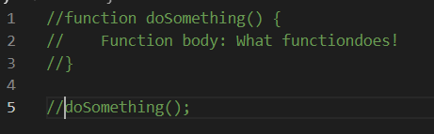
FUNCTIONS
A function is a reusable block of code that groups together a sequence of statements to perform a specific tasks.
Function Declaration
This is one way of creating a function. The function declaration binds a function to a name or identifier. It then includes a code block which is an abstraction (The bundling up of small atoms into a function, meaning to pull away in JavaScript, expressions and statements are bundled into abstractions called functions. )
Basic JavaScript Function Declaration:
Hoisting
A feature in JavaScript that allows us to do function declarations before they’re defined.
Calling a Function
This makes the code within the function body to run. A function call executes the function body and it can be called as many time as needed throughout different parts of the script.

Slide 43
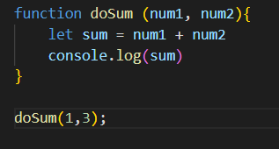
PARAMETERS AND ARGUMENTS
These two enable functions to take inputs and use the inputs to perform a task. When declaring a function, its parameters can be specified.
Parameters allow functions to accept input(s) and perform a task using the input(s). They’re used as placeholders for info that will be passed to the function when it is called. For example:
Arguments are the values passed to the function when it is called. Arguments can be passed to the function as variables or other functions.
Default parameters – These allow parameters to have a predetermined value in case there is no argument passed into the function or if the argument is undefined when called. (demo)

Slide 44
THE ‘RETURN’ KEYWORD
When a function is called, the computer will run through the function’s code and evaluate the result of calling the function. By default, that resulting value is undefined. (demo)
We capture the result by using the keyword ‘return’. To create a return statement we use the ‘return’ keyword followed by the value that we wish to return. If the value is omitted, undefined is returned instead.
FUNCTION EXPRESSIONS
To define a function inside a function expression, use the function keyword. The function name is usually omitted. A function with no name is called an anonymous function.
A function expression is often stored in variable in order to refer to it. (demo)

Slide 45
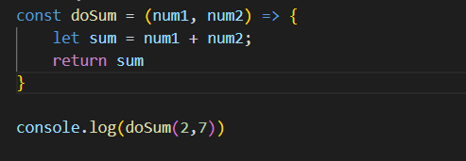
ARROW FUNCTIONS
We use arrow function as a shorter way of writing functions by using the special “fat arrow” notation.
They remove the need to type out the keyword function by including the parameters inside the () and then add an arrow => that points to the function body surrounded in {} like this:

Slide 46
Day 06 tasks
Create a folder for day 06 in your 21-days-of-javascript repo, and make the basic project structure
In your main.js:
write a function that checks whether a word is a palindrome
Write a function that greets people depending on their nationality (do five nationalities)
Write 3 mathematical functions using the three ways used to write JavaScript functions (expressions, declaration and arrow functions)

Slide 47
JavaScript: OBJECTS AND ARRAYS
DAY 07

Slide 48
OBJECTS
Objects is a JavaScript data type for collections of related data. It consists of properties separated by commas. It is not a primitive data type because it doesn’t not represent a single value, but instead a collection.
JavaScript objects can be used to model real-world things like a basketball, or to build the data structures that make the web possible. At their core, JavaScript objects are containers storing related data and functionality, but that deceptively simple task is extremely powerful in practice.
Concepts: Creating object literals, Accessing properties of objects, Property assignment, Object Methods, Nested Objects, Pass By reference, Looping through an object, The “this” keyword
Advanced Objects: Privacy, Getters and Setters, Factory Functions, Property value shorthand, Destructures Assignment
ARRAYS
Arrays are JavaScript’s way of making lists. They can store any type of data (strings, numbers, Booleans). They are considered objects as well, and like lists, arrays are ordered, meaning each item has a numbered position.
Concepts: Creating arrays, array structures and array manipulations

Slide 49
DIVING INTO ARRAYS
Creating an Array
We can create arrays using array literals, which is creating an array by wrapping items in square brackets and saving it to variable (demo)
Accessing Elements in an Array
Each element in an array has numbered position known as its index. The first index being “0” rather than one and we use these indexes to access elements(demo)
Nested Arrays
Arrays have the ability to store arrays within them. When an array contains another array, this is called a nested array
Array Manipulations:
Updating elements
Looping through arrays
Array Methods
Array Iterators

Slide 50
DIVING INTO objects
It is essential to understand the mechanics of objects because they are the basic structures that permeate nearly every aspect of programming in JavaScript, opening your code to more possibilities.
Creating Object Literals
Objects are enclosed between curly braces and assigned to variables just like any JavaScript data types, and they are filled with unordered data. The data is organized into key-value pairs. A key is what points to a location in memory that holds a value. (demo)
Accessing Properties
The dot notation and the bracket notation are used to access properties within an object.
Property Assignment
Objects are mutable, meaning we can update them after we create them. Dot Notation or bracket notation and the assignment operator (=) are used to add new key value pairs to an object or change an existing property. You can also delete a property from the object by using the delete operator
Object Methods
When the data stored in an object is a function we call that a method. A property is what an object has, while a method is what an object does. Methods can be included in object literals by creating key-value pairs, where the key is the method’s name and the value is an anonymous function expression (demo)

Slide 51
DIVING INTO objects
Nested Objects
An object might have another object as a property which in turn could have a property that’s an array of even more arrays and operators can be chained to access properties
Pass By Reference
Objects are passed by reference, meaning that when a variable is assigned to an object, it can be passed into a function as an argument. The computer interprets the parameter name as pointing to the space in the memory holding that object.
As a result, functions which change object properties actually mutate the object permanently(even when the object is assigned to a new variable). (demo)
Looping through Objects
Using the for…in, we can execute a given block of code for each property in an object (demo)
The ‘This’ Keyword
The this keyword references the calling object which provides access to the calling object’s properties. We can use arrow functions together with the “this” keyword to inherently bind or tie an already defined ‘this value’ to the function itself that is not the calling object.

Slide 52
Day 07 tasks
Create a folder for day 07 in your 21-days-of-javascript repo, and make the basic project structure and In your main.js:
Create an ARRAY and practice array structures and array manipulations
Create and OBJECT and REVIEW EVERYTHING WE HAVE COVERED ON WORKING WITH OBJECTS
Create HYPOTHETICAL MOVIE APPLICATION WHICH WILL ALLOW US TO CREATE A LIST OF MOVIES, DELETE THEM AND DISPLAY THE ENTRIES USING OBJECTS AND FUNCTIONS
SHARE LINKS OF YOUR DAY 07 TASKS FOLDER IN THE GROUP

Slide 53
JavaScript: jQuery introduction, selectors and CSS animation
DAY 08 and 09

Slide 54
introduction
jQuery is a JavaScript Library that makes it easy to add dynamic behavior to HTML elements, using a much simpler syntax than Vanilla JavaScript.
Library – This is a collection of objects and functions that can used individually and must be configured together.
Framework – This is an abstraction in which software, providing generic functionality can be selectively changed by additionally user-written code, thus providing application-specific software.
jQuery is used to quickly target HTML elements, manipulate the DOM(Document Object Model), CSS Animations and Event Handling. To use jQuery library, index.html must load it with the other dependencies.
We add this lines of code, just before the closing body tag because HTML files load from top to bottom adding jQuery and JS at the bottom of the page will ensure that it will not affect the HTML(Struture) and CSS load times.
Version of jQuery being used here is: https://cdnjs.cloudflare.com/ajax/libs/jquery/3.6.1/jquery.min.js

Slide 55
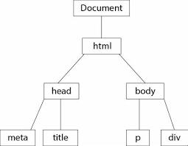
WHAT IS THE DOM?
The Document Object model (DOM) is a tree of objects based on the HTML document that is created by the browser by the browser when it loads a page. Every element in this HTML page exists on some branch of the tree, with elements above it, and possibly next to or below it. Elements inside other elements are considered descendants.
According to the DOM tree, the outermost element is the parent of all elements inside of it. Therefore, the HTML elements inside of the outer element are children.

Slide 56
jQuery Selectors AND SYNTAX
jQuery Syntax
The $() syntax can be used to create jQuery objects for elements on a web page. Typically, a string is passed into the $() to target individual elements within out HTML document.
jQuery Selectors
jQuery makes it easy to target HTML elements by tag name, class and id, and to also dynamically target a single element given in a class by accessing an event’s currentTarget attribute. Once targeted, (.) notation is used to attach a handler method that triggers a function.
Targeting by ID
This is used to target single elements and is done by prepending an elements id name with the # sign
Targeting by Class
This is used to target a group of elements within one class and is done by prepending an elements class name with the . sign
jQuery Objects
The $symbol is an alias for jQuery (the symbol is interchangeable with jQuery. The jQuery Function takes a parameter that targets an element and turns it into a jQuery object. Then, the jQuery method can be called on a jQuery object. Developers often save jQuery objects in variables

Slide 57
More…
jQuery Methods
With JavaScript, the possibilities are endless but time-consuming and jquery consists of pre-made structures known as jQuery Methods. These methods are used to add dynamic behaviour to HTML elements and CSS such as .hide(), .show(), .fadeIn(), .fadeout() etc to a HTML element.
.ready()
A webpage must first be rendered in a user’s browser before it is possible to have any dynamic behaviour. To solve this, we use the first jQuery Method: .ready()
This method waits until the HTML page’s Document Object Model is ready to manipulate. All of the JavaScript behaviour needs to be wrapped around this method to make sure the webpage is rendered in the browser before any jQuery code executes. (demo)

Slide 58
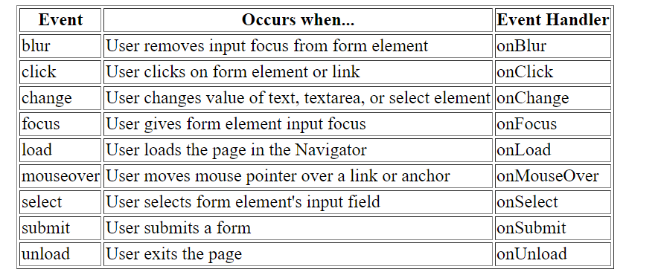
EVENT HANDLING
The jQuery .on() method adds event handlers to jQuery objects. The method adds event handlers to jQuery. It takes two parameters; a string declaring the event to listen for (the handler) and a callback function to fire when the event is detected.

Slide 59
jQuery EFFECTS
jQuery effects are a group of methods in the jQuery library library that are responsible for adding dynamic behaviour to websites. The can make elements disappear, fade in and out and slide around the page.
Examples of jQuery: .hide(), .show(), .toggle(), .fadeIn(1000), .fadeout(1000), .slidedown(‘slow’)
CSS ANIMATIONs
CSS and jQuery
One of the most powerful tools in jQuery allows the editing of CSS property values enabling the change of multiple visual aspects of an element at once.
To modify CSS properties of an element, jQuery provides one method called .css(). This method accepts an argument for a CSS property, and a corresponding CSS value(demo)

Slide 60
DEMO
LETS CREATE A WEB APPLICATION THAT ACCEPTS USER INPUT, PERFORMS A TASK AND DISPLAYS THE RESULT USING HTML, CSS AND JAVASCRIPT

Slide 61
Day 08 tasks
Create a folder for day 08 in your 21-days-of-javascript repo, and make the basic project structure and In your main.js:
Create a to-do list application where one can:
Input their tasks
Once they have created a task, they should see all their tasks
Delete a task from their to-do list once they have done it
SHARE LINKS OF YOUR DAY 08 TASKS FOLDER IN THE GROUP

Slide 62
Introduction to apiS
DAY 10

Slide 63
Day 10 tasks
COMPLETE THIS ONE HOUR COURSE BY POSTMAN ON API’s AND EARN A BADGE: https://bit.ly/studentexpertreg

Slide 64
PROJECT TWO
Html, CSS and JavaScript
Due : MONDAY 15TH JANUARY 2023, 10.00AM

Slide 65
PROJECT prompt
Assume you have a hypothetical stock management software company, where businesses use your software to keep track of their business’ stock. Using JavaScript, implement the core functionality of the System.

Slide 66
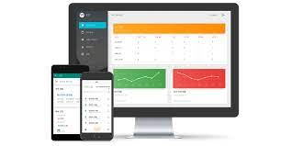
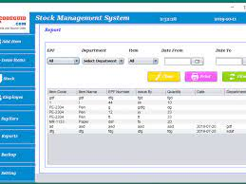
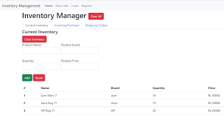

Slide 67
PROJECT guidelines
Create A new github repository and name it “product stock management
CREATE THE PRIMARY PROJECT STRUCTURE WITH ALL THE NECESSARY FILES AND FOLDERS
Create THE HOME PAGE FOR YOUR STOCK MANAGEMENT APPLICATION (optional)
Create the stock management WEB Application for the hypothetical product of your choosing (skin care products, car parts, electronics)
Write a clear documentation of the development process of this web application as well as how it works in your readme.md files.
PROJECT deliverables
You stock management system should be fully functional A person using your system can view their stock, dynamically add new items with required information(item name, quantity, date bought and supplier), edit existing items and removing items.
Your application should have at least 3 functionalities(mentioned above) and allow for dynamic updating of the quantity of items.
FEEL FREE TO EXPLORE STOCK MANAGEMENT DESIGNS.
Submit your STOCK MANAGEMENT SYSTEM URL HOSTED ON GITHUB PAGES.

